Slide 1
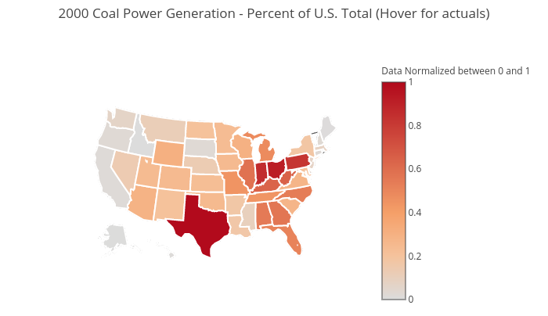
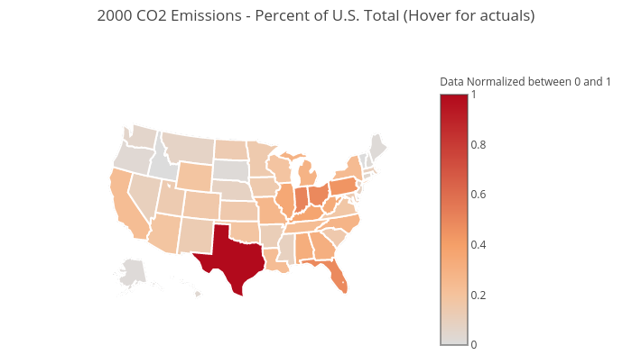
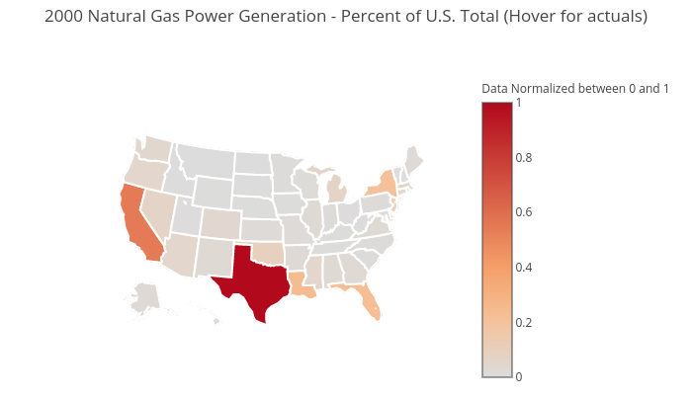
How does the fluctuation of energy source generation effect emissions? Year 2000
Click map to view actuals

Slide 2
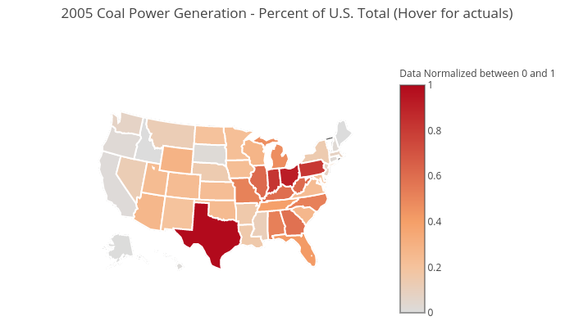
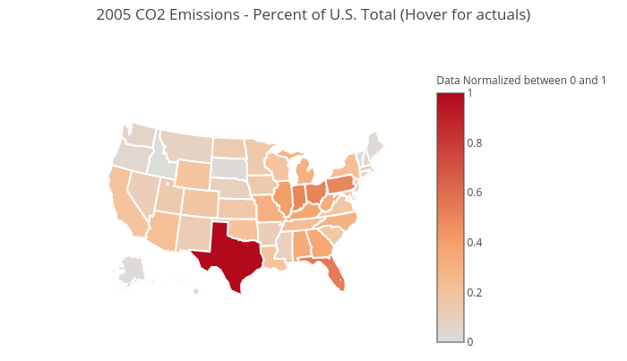
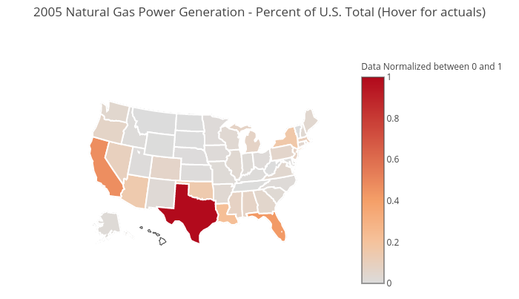
How does the fluctuation of energy source generation effect emissions? Year 2005
Click map to view actuals

Slide 3


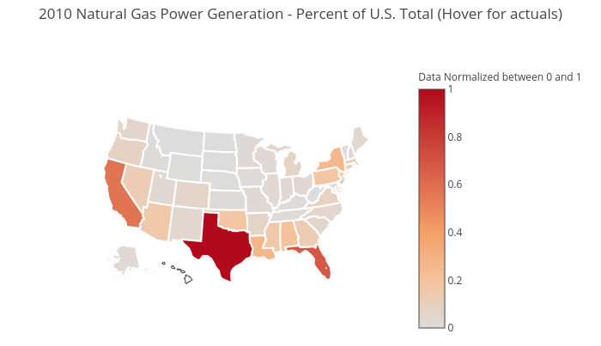
How does the fluctuation of energy source generation effect emissions? Year 2010
Click map to view actuals

Slide 4
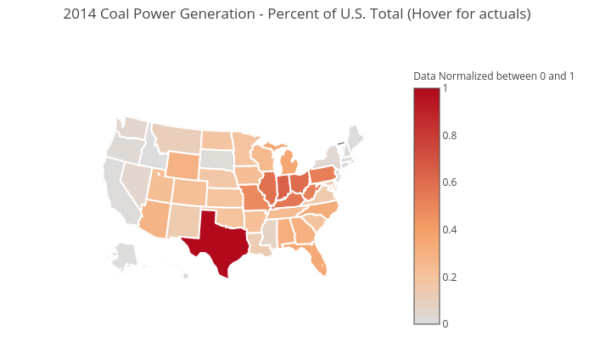

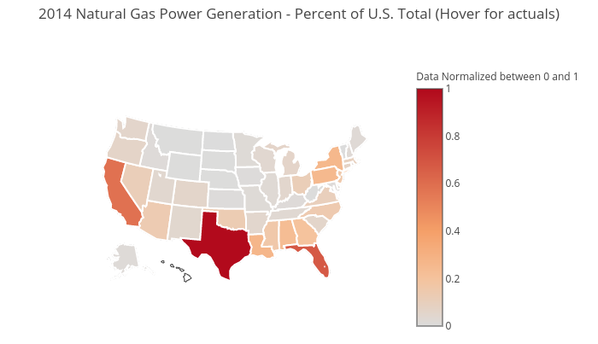
How does the fluctuation of energy source generation effect emissions? Year 2014
Click map to view actuals

Slide 5
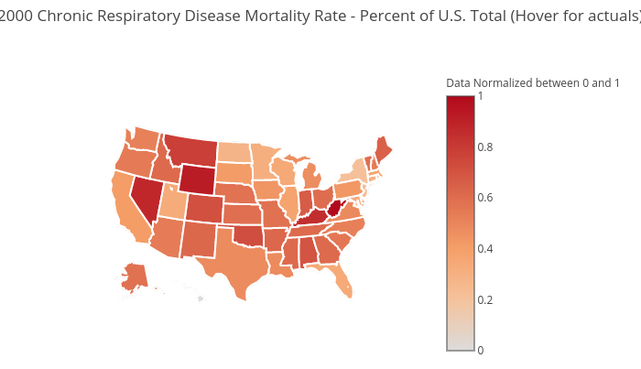
How does emissions effect respiratory health? Year 2000
Chronic Respiratory Disease Mortality Rate
CO2 Emissions
Click map to view actuals

Slide 6

How does emissions effect respiratory health? Year 2005
Chronic Respiratory Disease Mortality Rate
CO2 Emissions
Click map to view actuals

Slide 7

How does emissions effect respiratory health? Year 2010
Chronic Respiratory Disease Mortality Rate
CO2 Emissions
Click map to view actuals

Slide 8
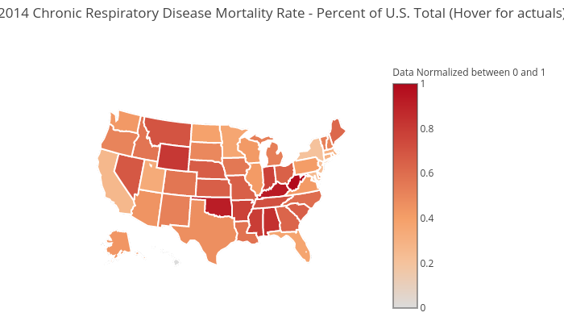
How does emissions effect respiratory health? Year 2014
Chronic Respiratory Disease Mortality Rate
CO2 Emissions
Click map to view actuals

Slide 9
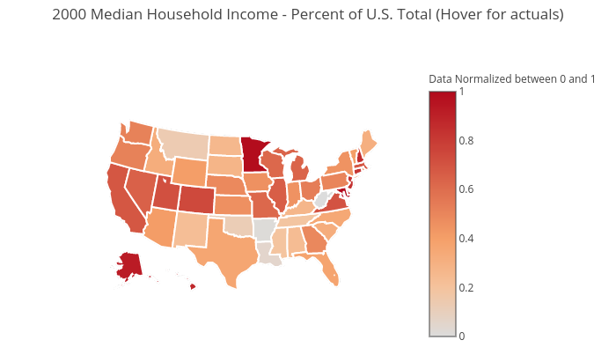
How does energy source generation relate to income? Year 2000
Click map to view actuals

Slide 10
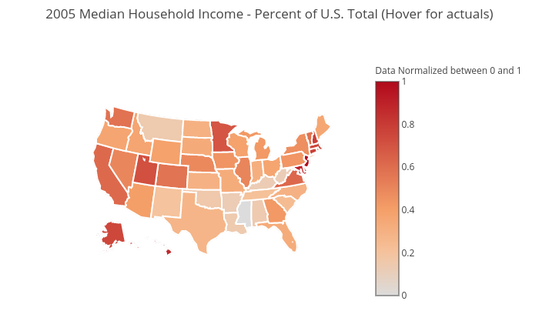
How does energy source generation relate to income? Year 2005
Click map to view actuals

Slide 11
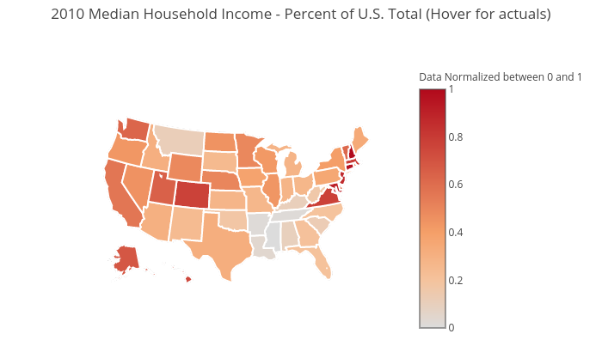
How does energy source generation relate to income? Year 2010
Click map to view actuals

Slide 12
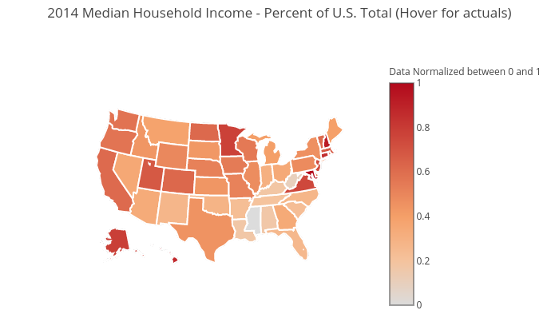
How does energy source generation relate to income? Year 2014
Click map to view actuals

Slide 13
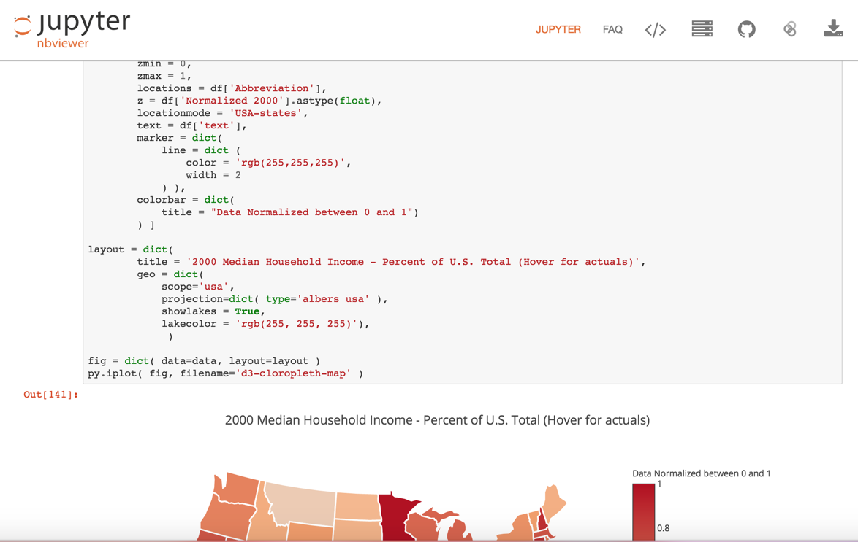
View Map Code on Jupyter nbviewer

Slide 14
Click map to view actuals

Slide 15
Coal Power Generation vs CO2 Emissions Year 2000
Coal Power Generation
CO2 Emissions
Click map to view actuals

Slide 16
Natural Gas Power Generation vs CO2 Emissions Year 2000
Natural Gas Power Generation
CO2 Emissions
Click map to view actuals

Slide 17
Chronic Respiratory Disease Mortality Rate vs CO2 Emissions Year 2000
Chronic Respiratory Disease Mortality Rate
CO2 Emissions
Click map to view actuals

Slide 18
Chronic Respiratory Disease Mortality Rate vs Median Household Income Year 2000
Chronic Respiratory Disease Mortality Rate
Median Household Income
Click map to view actuals

Slide 19
Coal Power Generation vs Median Household Income Year 2000
Coal Power Generation
Median Household Income
Click map to view actuals

Slide 20
Natural Gas Power Generation vs Median Household Income Year 2000
Natural Gas Power Generation
Median Household Income
Click map to view actuals

Slide 21
Click map to view actuals

Slide 22
Coal Power Generation vs CO2 Emissions Year 2005
Coal Power Generation
CO2 Emissions
Click map to view actuals

Slide 23
Natural Gas Power Generation vs CO2 Emissions Year 2005
Natural Gas Power Generation
CO2 Emissions
Click map to view actuals

Slide 24
Chronic Respiratory Disease Mortality Rate vs CO2 Emissions Year 2005
Chronic Respiratory Disease Mortality Rate
CO2 Emissions
Click map to view actuals

Slide 25
Chronic Respiratory Disease Mortality Rate vs Median Household Income Year 2005
Chronic Respiratory Disease Mortality Rate
Median Household Income
Click map to view actuals

Slide 26
Coal Power Generation vs Median Household Income Year 2005
Coal Power Generation
Median Household Income
Click map to view actuals

Slide 27
Natural Gas Power Generation vs Median Household Income Year 2005
Natural Gas Power Generation
Median Household Income
Click map to view actuals

Slide 28
Click map to view actuals

Slide 29
Coal Power Generation vs CO2 Emissions Year 2010
Coal Power Generation
CO2 Emissions
Click map to view actuals

Slide 30
Natural Gas Power Generation vs CO2 Emissions Year 2010
Natural Gas Power Generation
CO2 Emissions
Click map to view actuals

Slide 31
Chronic Respiratory Disease Mortality Rate vs CO2 Emissions Year 2010
Chronic Respiratory Disease Mortality Rate
CO2 Emissions
Click map to view actuals

Slide 32
Chronic Respiratory Disease Mortality Rate vs Median Household Income Year 2010
Chronic Respiratory Disease Mortality Rate
Median Household Income
Click map to view actuals

Slide 33
Coal Power Generation vs Median Household Income Year 2010
Coal Power Generation
Median Household Income
Click map to view actuals

Slide 34
Natural Gas Power Generation vs Median Household Income Year 2010
Natural Gas Power Generation
Median Household Income
Click map to view actuals

Slide 35
Click map to view actuals

Slide 36
Coal Power Generation vs CO2 Emissions Year 2014
Coal Power Generation
CO2 Emissions
Click map to view actuals

Slide 37
Natural Gas Power Generation vs CO2 Emissions Year 2014
Natural Gas Power Generation
CO2 Emissions
Click map to view actuals

Slide 38
Chronic Respiratory Disease Mortality Rate vs CO2 Emissions Year 2014
Chronic Respiratory Disease Mortality Rate
CO2 Emissions
Click map to view actuals

Slide 39
Chronic Respiratory Disease Mortality Rate vs Median Household Income Year 2014
Chronic Respiratory Disease Mortality Rate
Median Household Income
Click map to view actuals

Slide 40
Coal Power Generation vs Median Household Income Year 2014
Coal Power Generation
Median Household Income
Click map to view actuals

Slide 41
Natural Gas Power Generation vs Median Household Income Year 2014
Natural Gas Power Generation
Median Household Income
Click map to view actuals

Slide 42
How does the fluctuation of energy source generation effect emissions? Year 2014

